Slide 1

RNS Institute of Technology
IPL Auction Statistics Using B-Tree Indexing Structure
Faculty Incharge : Mr. RajKumar
Co-ordinator : Mrs. Vinutha G K
Sailesh Khandelwal 1RN16IS083
Roshan Kumar Patro 1RN16IS081

Slide 2
Introduction
This mini project IPL Auction Statistics is a simple file structure project in C++. It is implemented using the file handling mechanisms in C++.
The records of the players can be added, searched, updated, deleted and displayed.
We have used the concept of B-Tree Indexing for updating, searching and deletion in this file structure project.

Slide 3
History
Access was sequential, and the cost of access grew in direct proportion, to the size of the file since we were using Disk tapes in the beginning.
The indexes made it possible to keep a list of keys and pointers in a smaller file that could be searched more quickly. With key and pointer, the user had direct access to the large, primary file.
But simple indexes had some of the same sequential flaws as the data file, and as the indexes grew, they too became difficult to manage, especially for dynamic files in which the set of keys changes.
In the early 1960‟s, the idea of applying tree structures emerged. But trees can grow very unevenly as records are added and deleted, resulting in long searches requiring many disk accesses to find a record.
In 1963, researchers developed an elegant, self-adjusting binary tree structure, called AVL tree, for data in memory. The problem was that, even with a balanced binary tree, dozens of accesses were required to find a record in even moderate-sized files.

Slide 4
Continued…
A method was needed to keep a tree balanced when each node of thee tree was not a single record, as in a binary tree, but a file block containing dozens, perhaps even hundreds, of records took 10 years until a solution emerged in the form of a B-Tree.
Whereas AVL trees grow from the top down as records were added, B-Trees grew from the bottom up. B-Trees provided excellent access performance.
But there was a cost: no longer could a file be accessed sequentially with efficiency. The problem was solved by adding a linked list structure at the bottom level of the B-Tree. The combination of a B-Tree and a sequential linked list is called a B+ tree.
Hashing is a good way to get what we want with a single request, with files that do not change size greatly over time. Hashed indexes were used to provide fast access to files.
But until recently, hashing did not work well with volatile, dynamic files. Extendible dynamic hashing can retrieve information with 1 or at most 2 disk accesses, no matter how big the file became.

Slide 5
Storing Fields and records
Fixing the Length of Fields: In the IPL Auction Statistics mini-project field is a character array that can hold a string value of variable size. Here other fields are character array, here the Player ID is the primary key which holds the primary key of the records. By using the Player ID the entire records can be easily obtained.
Separating the Fields with Delimiters: We preserve the identity of fields by separating them with delimiters. We have chosen the vertical bar character (|), as the delimiter here.
Making Records a Predictable Number of Fields: In this system, we have a fixed number of fields, each with a variable length, that combine to make a data record. Fixing the number of fields in a record does not imply that the size of fields in the record is fixed. The records are used as containers to hold a mix of fixed and variable-length fields within a record. We have 5 contiguous fields.
We use a B-Tree of indexes to keep byte offsets for each record in the original file.
Our choice of a record delimiter for the data files is hash(“#‟) to mark end of one record.

Slide 6
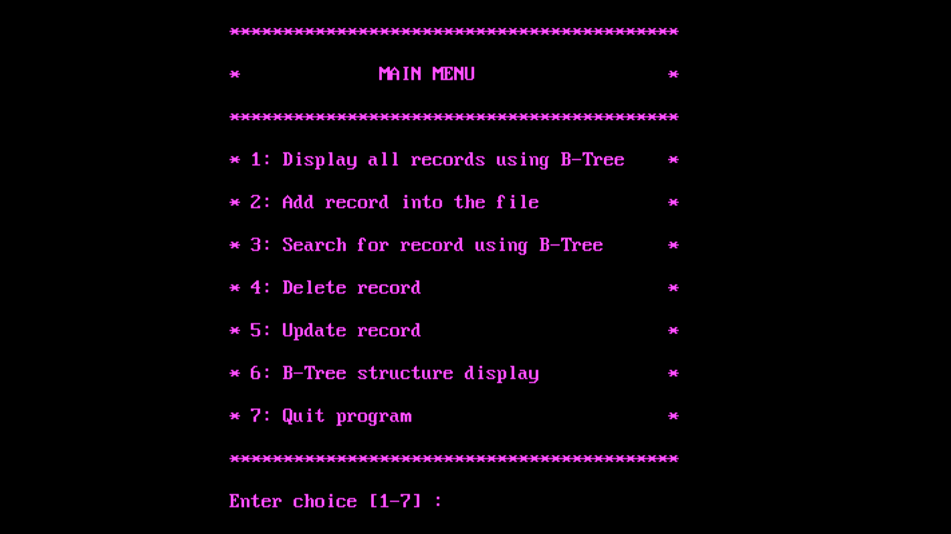
User menu

Slide 7
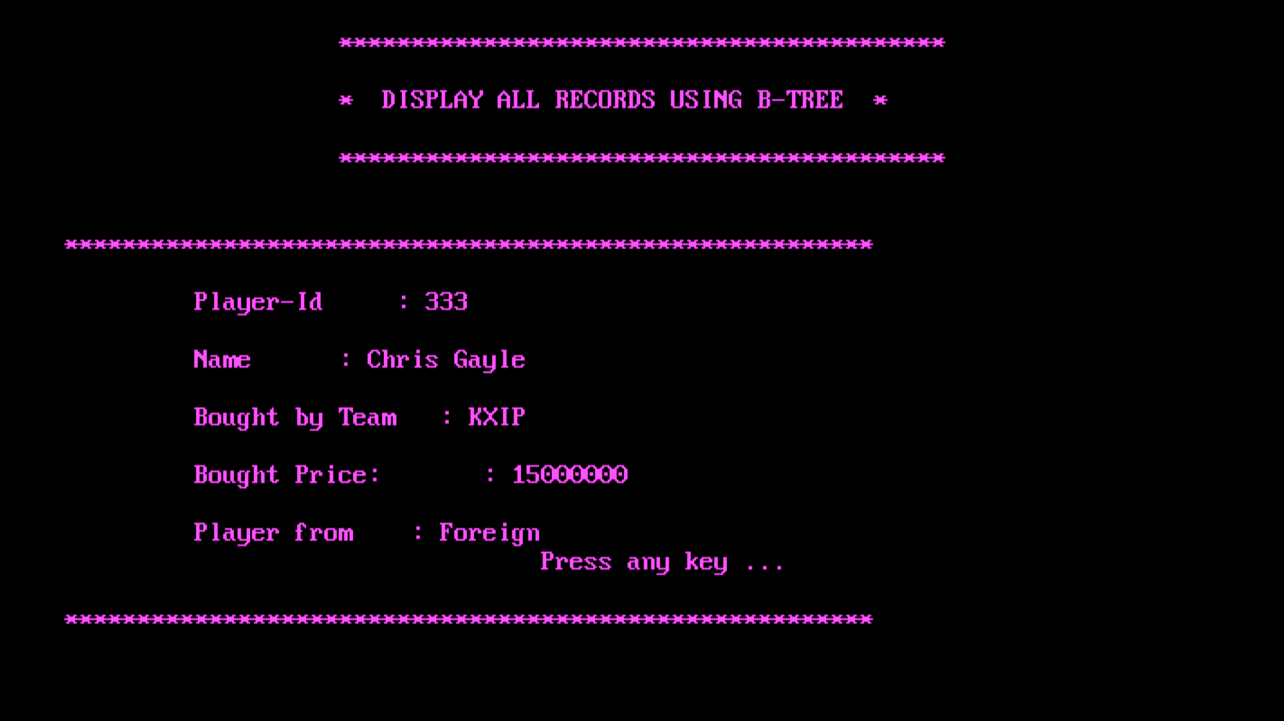
Display Records using B-Tree

Slide 8
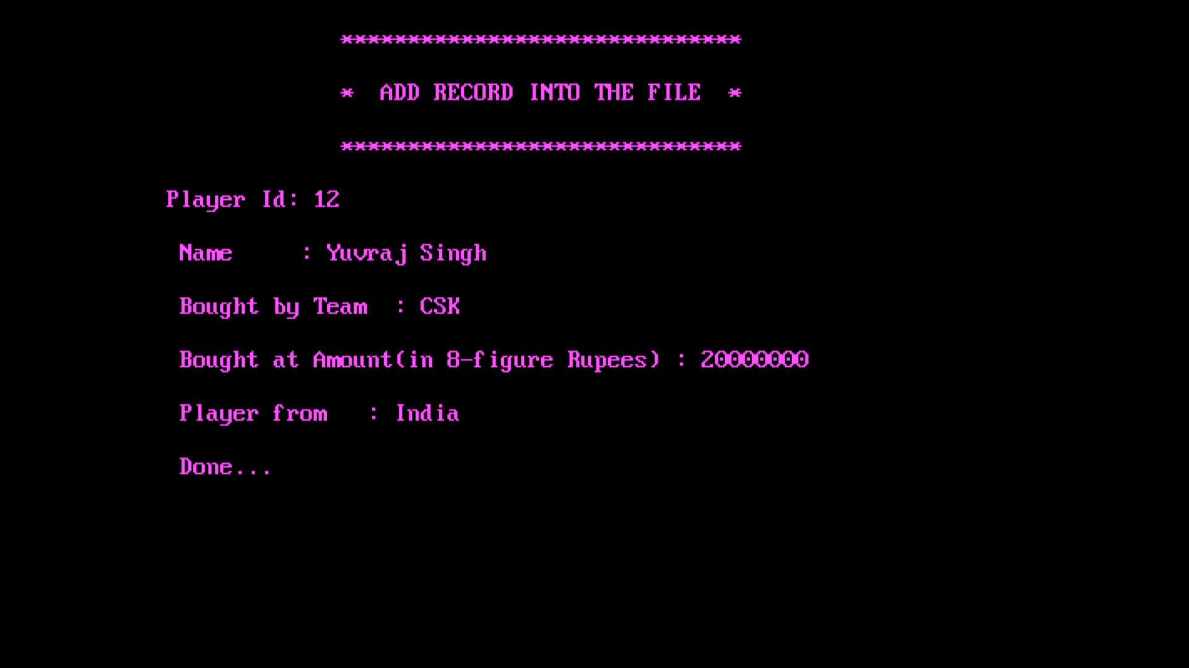
Addition of record into the file

Slide 9
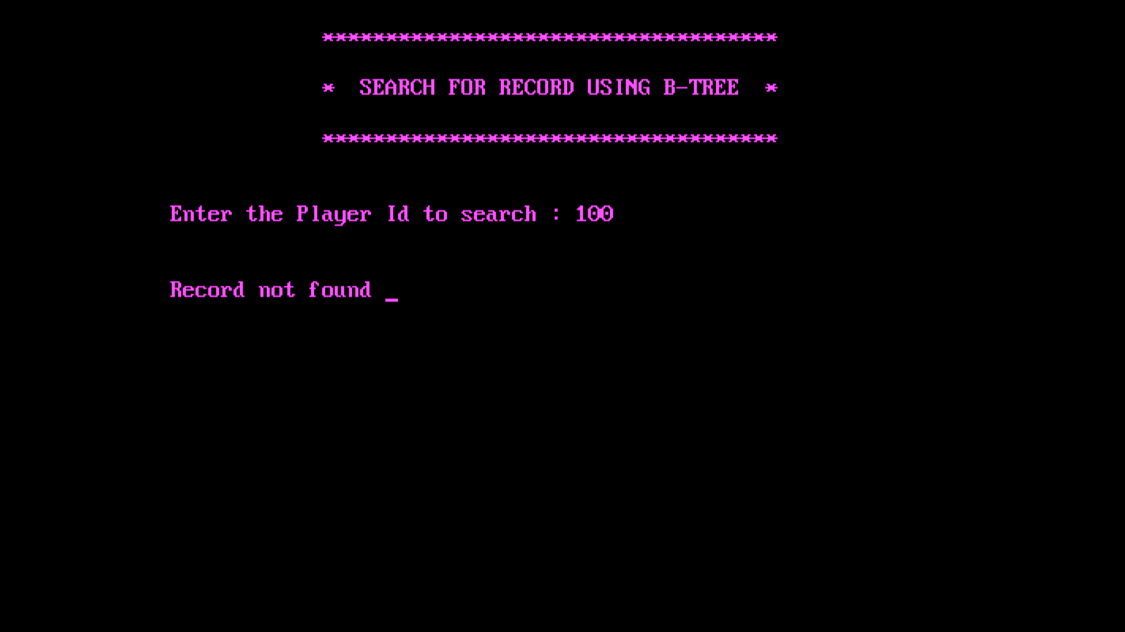
Unsuccessful Record Search

Slide 10
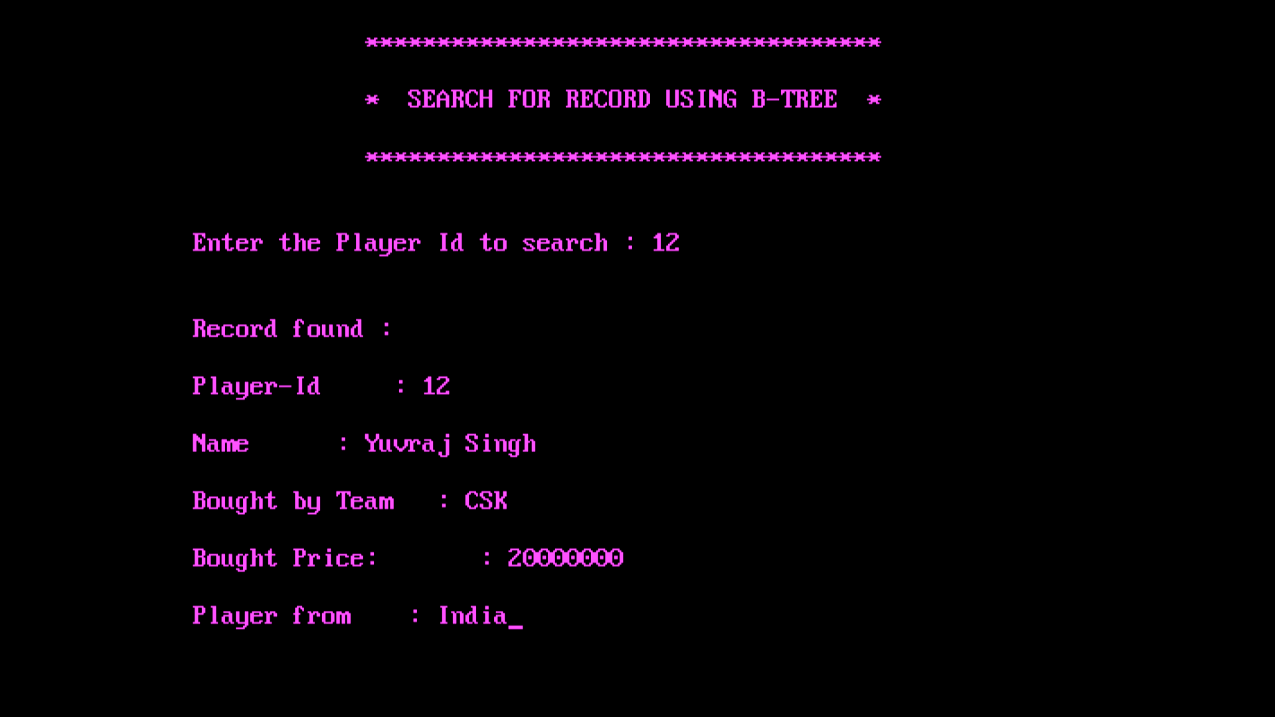
Successful Record Search

Slide 11
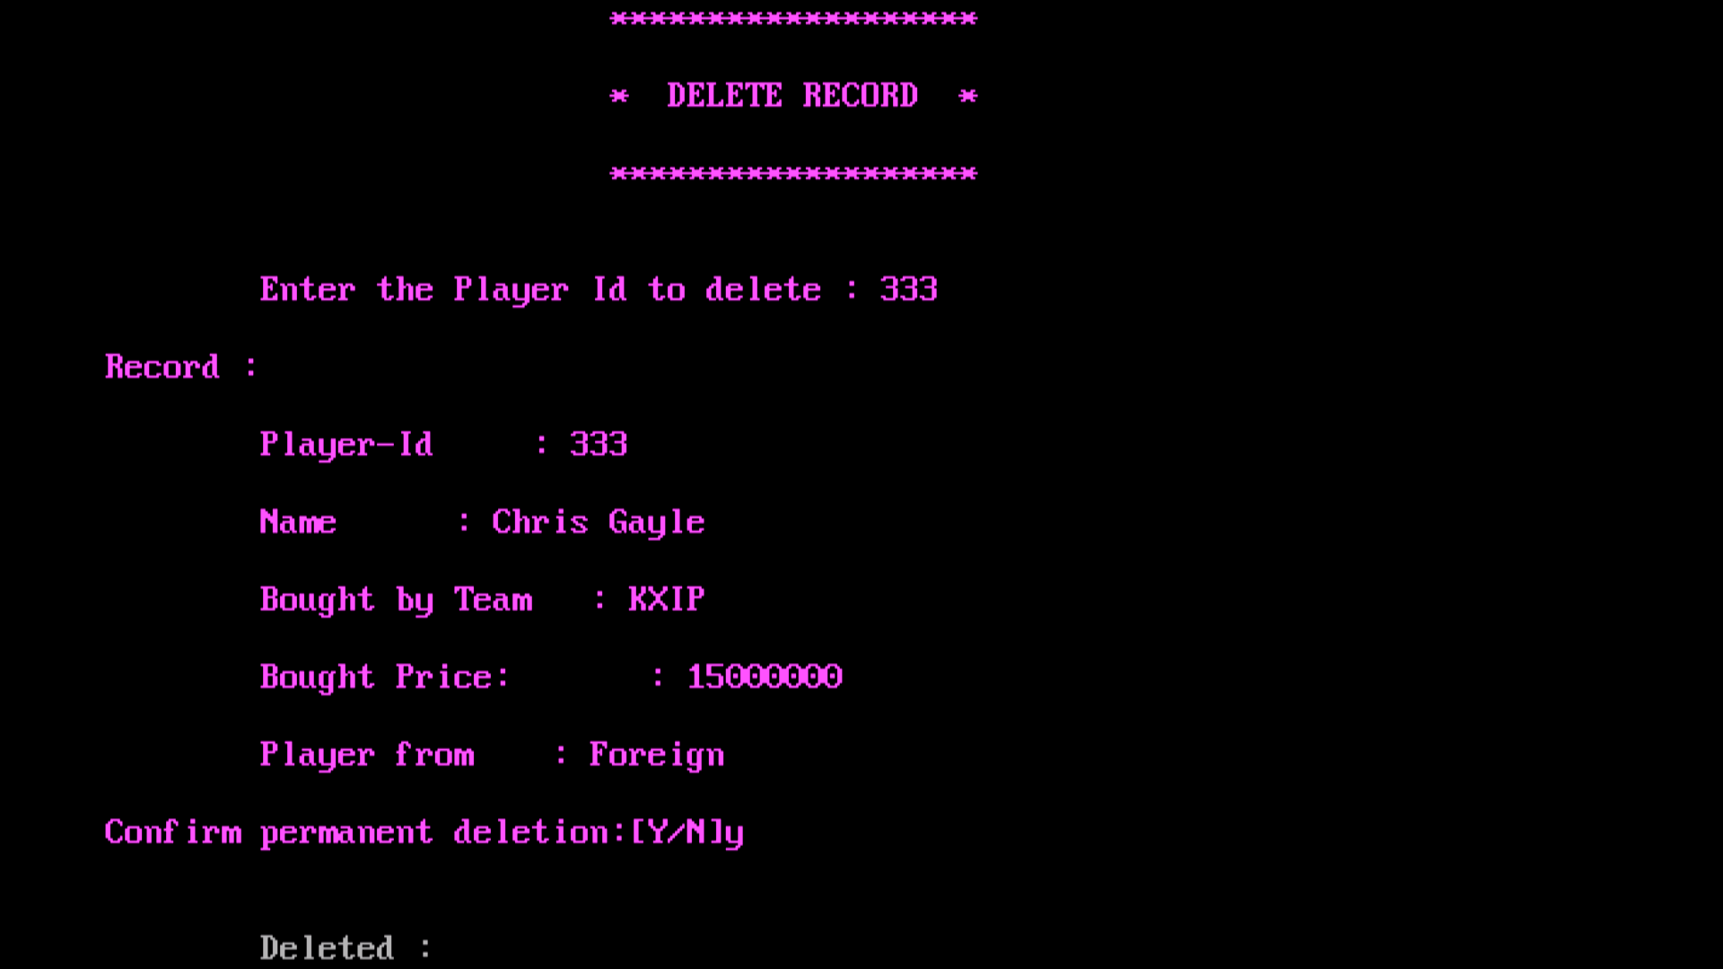
Deleting Record

Slide 12
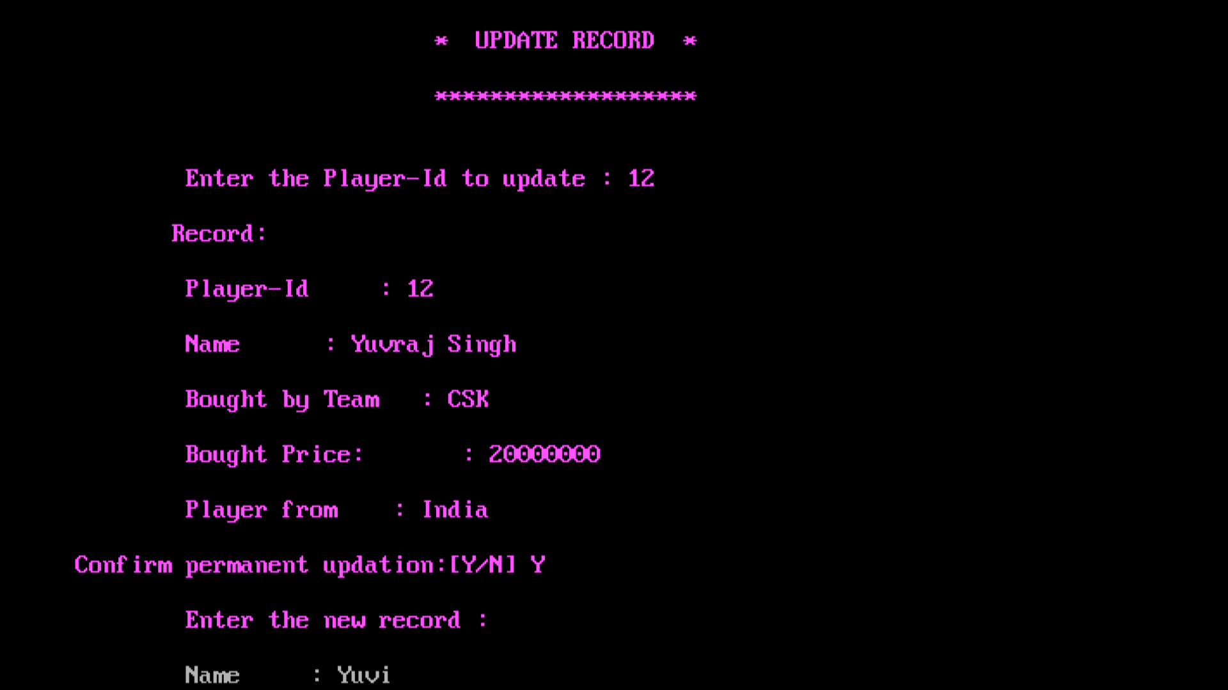
Updating Record

Slide 13
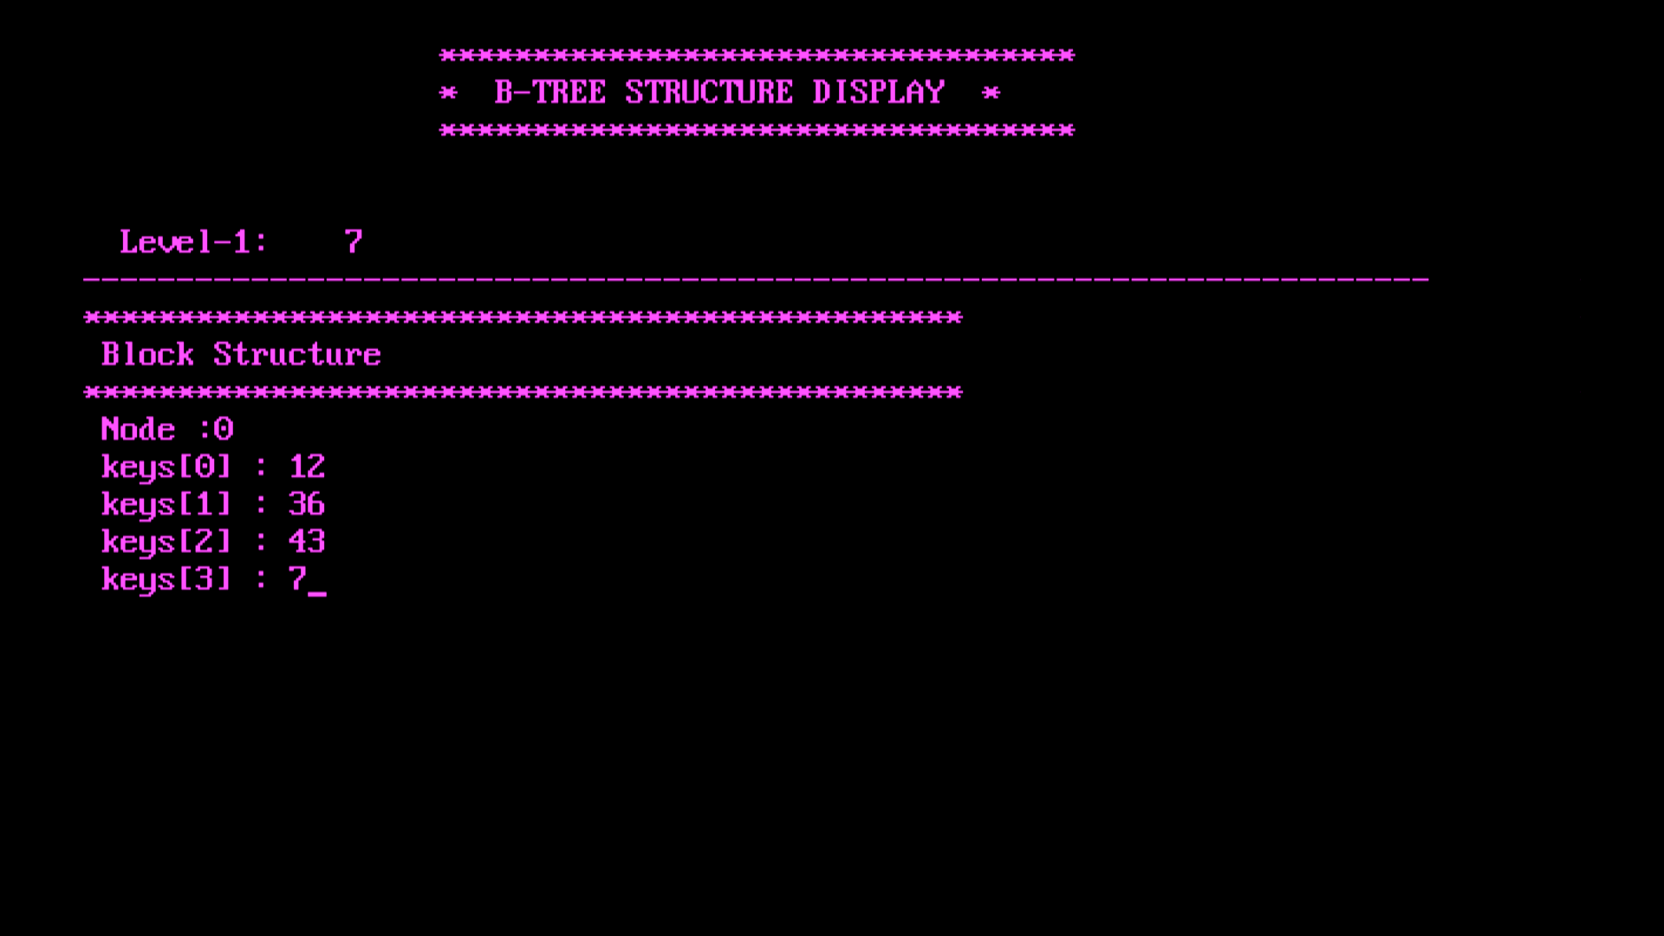
B-Tree Levels Display

Slide 14
Applications of the project
This software can help the cricket boards to work with different teams and players easily.
This software reduces the amount of manual data entry and gives greater efficiency.
The User Interface of it is very friendly and can be easily used by anyone.
It also decreases the amount of time taken to write player’s details and other modules.

Slide 15
Conclusion
Atlast ,We would like to conclude that we learnt a lot about B-tree and about file structures in general during the course of making of this project.
So, We take this opportunity to express our profound gratitude and deep regards to our faculty Ms. Vinutha mam for her exemplary guidance, monitoring and constant encouragement throughout the course of this project.

